Slide 1
利用LSTM與主機端資訊管理write buffer的方法
Presenter : Sheng-Ying-Huang
Adviser: Dr.Hsung-Pin Chang
Department of Computer Science and Engineering National Chung Hsing University

Slide 2
Outline
Introduction
Motivation
Contribution
Background
Design
Experiment

Slide 3



Introduction
Pros
SSD
Price
Fast
capacity
Resistance
Notes:
used in portable storage devices and handheld devices.
Recently, flash memory has been adopted by personal computers and servers in the form of onboard cache and solid-state disk (SSD).

Slide 4
Introduction
D
Cons
Out-of-place-update
Lifetime
Write request
update
D
Invalid
D
Operation | Unit
Read | Page
Write | Page
Erase | Block
C
Valid
B
Valid
A
Valid
SSD
When GC happen

Slide 5
Introduction
What if there are too many write operations?
solution: write buffer(based on RAM)
Page cache
Host
In-place-update
Write buffer
SSD
FTL
Flash memory
Notes:
Reduce erase count->reduce waiting time->good performance

Slide 6
Introduction
Page 8 overwrite many times
Page cache
Page cache
Dirty page
9 10 11 12 13
5
6
7
8
9 10 11 12 13
5
6
7
8
Dirty page
hit
Erase
Write buffer
6
5
Flash memory
SSD
SSD

Slide 7
Outline
Introduction
Motivation
Contribution
Background
Design
Experiment

Slide 8
Motivation
Write buffer can improve SSD lifetime, but we need to make sure write buffer has high hit ratio.
Current write buffer design: don’t know the trend of request
Page cache
victim
Write buffer
5 4 8 9 11 25 33 15 1 2 16 28 7
MRU
LRU
request
19 16 15 14 7 7 7 7 7 7 7 7 28 16 2
We never know future request

Slide 9
Outline
Introduction
Motivation
Contribution
Background
Design
Experiment

Slide 10
Contribution
Host
Page cache
AI model
Write buffer
Hint queue
FTL
Flash memory
SSD

Slide 11
Outline
Introduction
Motivation
Contribution
Background
Physical block-based write buffer
Neural network
LSTM(Long short-term memory)
Design
Experiment

Slide 12
Physical block-based write buffer
Background
Host
Page cache
Write dirty page in three cases:
Replacement
Dirty amount
Dirty time
Store dirty page
Hint queue help write buffer select victim
Hint queue
Write buffer
Flash memory
SSD
Notes:
Write buffer管理分成以physical block管理或是logical block管理，如果是以physical block管理……

Slide 13
Replacement
Background
Clean page
Page cache
46
11
94
7
68
55
39
21
5
15
Dirty page
MRU
LRU
SSD
94
68
21

Slide 14
Flush due to dirty page amount
Background
Clean page
Page cache size=10 pages
Dirty page ratio=50%
Dirty page ratio=20%
Dirty page ratio=40%
Dirty page ratio=30%
Dirty page
Dirty page ratio=10%
84
16
28
19
5
71
1
15
51
84
21
19
5
15
Page cache
51
MRU
LRU
SSD
19
5
15

Slide 15
Flush due to dirty time
Background
Clean page
Page cache
46
11
94
7
68
55
39
21
5
15
Dirty page
MRU
LRU
More than 30 seconds
Global time flag
SSD
46
11
94

Slide 16
Outline
Introduction
Motivation
Contribution
Background
Physical block-based write buffer
Neural network
LSTM(Long short-term memory)
Design
Experiment

Slide 17
Neural network
Background
Background
Neural network
Label
Output layer
x1
y1
0
Activation function
x2
y2
0
…....
…....
…....
1
xn
yn
classification
Weight
neural
Input feature
(vector)
Calculate loss
Backpropagation
Notes:
Goal: find the function
給這個函式一個input，他能夠回傳這個任務（預測圖片＆天氣＆股票價位）的結果
而這樣的函式，是沒辦法靠人所找出來的，因此需要機器去逼近！

Slide 18
Outline
Introduction
Motivation
Contribution
Background
Physical block-based write buffer
Neural network
RNN(recurrent neural network)
LSTM(Long short-term memory)
Design
Experiment

Slide 19
Background
RNN(recurrent neural network)
Neural network
memory
RNN
Simple RNN
Short term memory
RNN
LSTM
Long short-term memory

Slide 20
Background
LSTM
x1
LSTM unit
x2
Activation function
LSTM unit
output
x3
LSTM unit
Input feature
(vector)
LSTM unit
LSTM layer

Slide 21
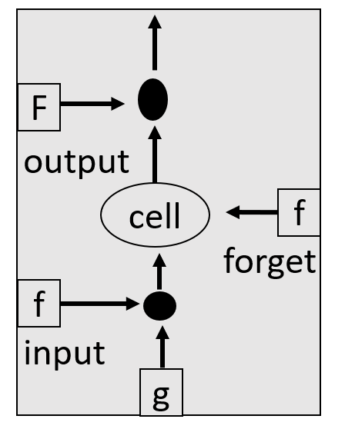
LSTM
Background
W1
Input feature
Zo
vector
W2
Input feature
Zf
W3
Input feature
Z
W4
Input feature
Zi
Notes:
X-→當下狀態(初始值)是好還是壞…..，決定是否將資訊送進memory
Forget gate-→決定是否記住上次memory資訊
Output gate→決定是否輸出

Slide 22
LSTM
Background
w1
w2
w3
w4
2
1
5
4
5
1
5
3
3
1
1
2
1
7
5
Zi
52
13
45
35
W4
Input feature
Number of LSTM unit
w1
Input feature
w3
Input feature
2
5
3
1
7
5
5
5
1
1
7
5
w2
Input feature
w4
Input feature
1
1
1
1
7
5
4
3
2
1
7
5
Notes:
X-→當下狀態(初始值)是好還是壞…..，決定是否將資訊送進memory
Forget gate-→決定是否記住上次memory資訊
Output gate→決定是否輸出

Slide 23
LSTM
Background
35
6
0
1
45
63
1
35
13
90
10
50
52
9
7
5
Zi
Z
Zo
Zf

Slide 24
LSTM
Background
O
f=activation function → sigmoid
f
O=f(Zo)*C’
Zo
C’=f(zf)*C+X
C’
C
Zf
X
Zi
X=g *f(zi)
Z
Notes:
X-→當下狀態(初始值)是好還是壞…..，決定是否將資訊送進memory
Forget gate-→決定是否記住上次memory資訊
Output gate→決定是否輸出

Slide 25
LSTM
Background
y1
Zi
y2
X
Zo
Zf
Y
Z
yn

Slide 26
LSTM
Background
Y1
Y2
Y3
Yn
Output
Memory
cell
Memory
cell
Memory
cell
Memory
cell
X1
X2
X3
Xn
Time 1
Time 2
Time 3
Time n

Slide 27
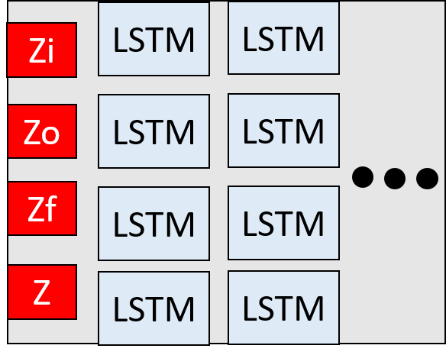
LSTM
Background
Input feature
Y(4*1 vector)
softmax
LSTM
LSTM
LSTM
LSTM unit
Output
(0/1/2)
[1,0,0]
Or
[0 ,1,0]
Or
[0,0,1]
Notes:
LSTM第一層輸出會成為第二層輸入，第二層輸出會成為第三層輸入，因此在寫code的時候，只會管你第一層的input shape有沒有對，其餘的keras就不會管了！

Slide 28
Outline
Introduction
Motivation
Contribution
Background
Design
Architecture
Write buffer management: AI
Offline
Online
Experiment

Slide 29
Architecture
Host
Page cache
AI model
Late queue
Hint queue
Mean queue
Soon queue
MRU
LRU
Write buffer
Flash memory
SSD
29

Slide 30
Offline
Architecture
Write buffer simulator
Generate duration label
Training

Slide 31




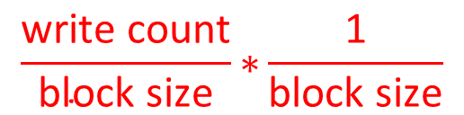
Offline
Architecture
Offline
Benefit function
Oracle
Write buffer simulator
AI training
$$\frac{\text{write} \text{count}}{\text{block} \text{size}}\text{∗}\frac{\text{1}}{\text{block} \text{size}}$$
Duration value
Number of page in current block

Slide 32
Write buffer simulator
Offline
2
5
8
 | Benefit value
LB 0 | 0.1
LB 1 | 0.5
LB 2 | 0.45
LB 3 | 0.7
LB 4 | 0.3
LB 5 | 0.6
LB 6 | 0.5
LB 7 | 0.73
1
4
7
Write buffer
0
3
6
9
LB 0
LB 1
LB 2
LB 3
Block/Time | T1 | T2 | T3 | T4 | T5 | T6
LB 0 | 0
Block/Time | T1 | T2 | T3 | T4 | T5 | T6
LB 0 | 0 | 1
LB 1 |  | 0
Block/Time | T1 | T2 | T3 | T4 | T5 | T6
LB 0 | 0 | 1 | 2
LB 1 |  | 0 | 1
Block/Time | T1 | T2 | T3 | T4 | T5 | T6
LB 0 | 0 | 1 | 2 | 3
LB 1 |  | 0 | 1 | 2
Block/Time | T1 | T2 | T3 | T4 | T5 | T6
LB 0 | 0 | 1 | 2 | 3 | 4
LB 1 |  | 0 | 1 | 2 | 3
Block/Time | T1 | T2 | T3 | T4 | T5 | T6
LB 0 |  | 1 | 2 | 3 | 4 | 5
LB 1 |  | 0 | 1 | 2 | 3 | 4
Block/Time | T7 | T8 | T9 | T10 | T11 | T12
LB 0 | 6
LB 1 | 5
LB 2 | 0
Block/Time | T7 | T8 | T9 | T10 | T11 | T12
LB 0 | 6 | 7
LB 1 | 5 | 6
LB 2 | 0 | 1
Block/Time | T7 | T8 | T9 | T10 | T11 | T12
LB 0 | 6 | 7 | 8
LB 1 | 5 | 6 | 7
LB 2 | 0 | 1 | 2
Block/Time | T7 | T8 | T9 | T10 | T11 | T12
LB 0 | 6 | 7 | 8
LB 1 | 5 | 6 | 7 | 8
LB 2 | 0 | 1 | 2 | 3
LB 3 |  |  |  | 0
LB 0 duration=8
Duration value

Slide 33
Offline
Write buffer simulator
LB 0
LB 1
LB 2
LB 3
LB 4
LB 5
LB 6
LB 7
Write buffer simulator
LB 0
4
LB 1
5
LB 2
14
LB 3
19
Block
duration
Block
duration
Block
duration
Block
duration
LB 4
9
LB 5
7
LB
13
LB 8
102
Block
duration
Block
duration
Block
duration
Block
duration

Slide 34
Generate duration label
Offline
Transform duration value into duration label
Duration value : d
Threshold :t
d<t
d>=t & d<5t
d>=5t
Soon->0
Mean->1
Late->2

Slide 35
Offline
Training
Y
Calculate loss
Duration label
X1
X2
LSTM
LSTM
LSTM
output
softmax
[1,0,0]
Or
[0 ,1,0]
Or
[0,0,1]
X3
Input feature
Backpropagation

Slide 36
Outline
Introduction
Motivation
Contribution
Background
Design
Write buffer management: AI
Offline
Online
Write buffer management: AI+Hint
Experiment

Slide 37
Online
Architecture
Testing
Demoting

Slide 38


Online
Architecture
Online
Demoting
Predict duration label
Request
LSTM model
Write buffer

Slide 39
Demoting
Online
Host
Page cache
Late queue
MRU
LRU
Demoting
Mean queue
MRU
LRU
Soon queue
MRU
LRU
Write buffer
Flash memory

Slide 40
Demoting
Online
Demoting
Threshold=4000
Block | Pass request count
A | 7
B | 5182
C | 5697
D | 21
E | 4466
F | 4458
G | 9
H | 6
I | 413
late queue
A
J
K
L
B
C
MRU
LRU
mean queue
G
M
N
O
F
E
MRU
LRU
soon queue
H
D
I
P
MRU
LRU
Write buffer
If access, reset to 0

Slide 41
Outline
Introduction
Motivation
Contribution
Background
Design
Write buffer management: AI
Offline
Online
Write buffer management: AI+Hint
Experiment

Slide 42
Write buffer management: AI+Hint
Architecture
Using Hint information

Slide 43


Online
Architecture
Online
Write buffer
Request
Predict duration label
LSTM model
Page Cache
Hint Queue

Slide 44
Using hint information
Online
E
B
C
A
D
Victim block
Write buffer—soon queue
MRU
LRU
Page 51 is not in block D
Page 51
New write
Page 40
Page 40
overwrite
Page 25~39
Page 24
Page 24
overwrite
Page 2~23
Page 1
Page 1
overwrite
D
Hint

Slide 45
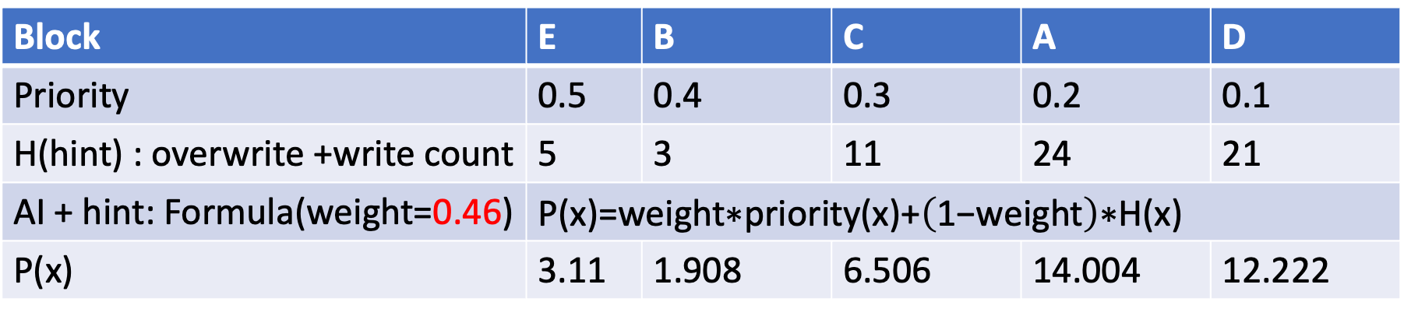
Using hint information
Online
Write buffer soon queue
Victim block
E
B
C
A
D
MRU
LRU
Block | E | B | C | A | D
Priority | 0.5 | 0.4 | 0.3 | 0.2 | 0.1
H(hint) : overwrite +write count | 5 | 3 | 11 | 24 | 21
AI + hint: Formula(weight=0.46) | $$\text{P}\text{(}\text{x}\text{)=}\text{weight}\text{∗}\text{priority}\text{(}\text{x}\text{)+}\left(\text{1−}\text{weight}\right)\text{∗}\text{H}\text{(}\text{x}\text{)}$$
P(x) | 3.11 | 1.908 | 6.506 | 14.004 | 12.222
Too close to MRU
Write buffer soon queue(in the future)
Other block
B
MRU
LRU

Slide 46
Outline
Introduction
Motivation
Contribution
Background
Design
Experiment

Slide 47
Experiment

Slide 48
Experiment

